Slide 1
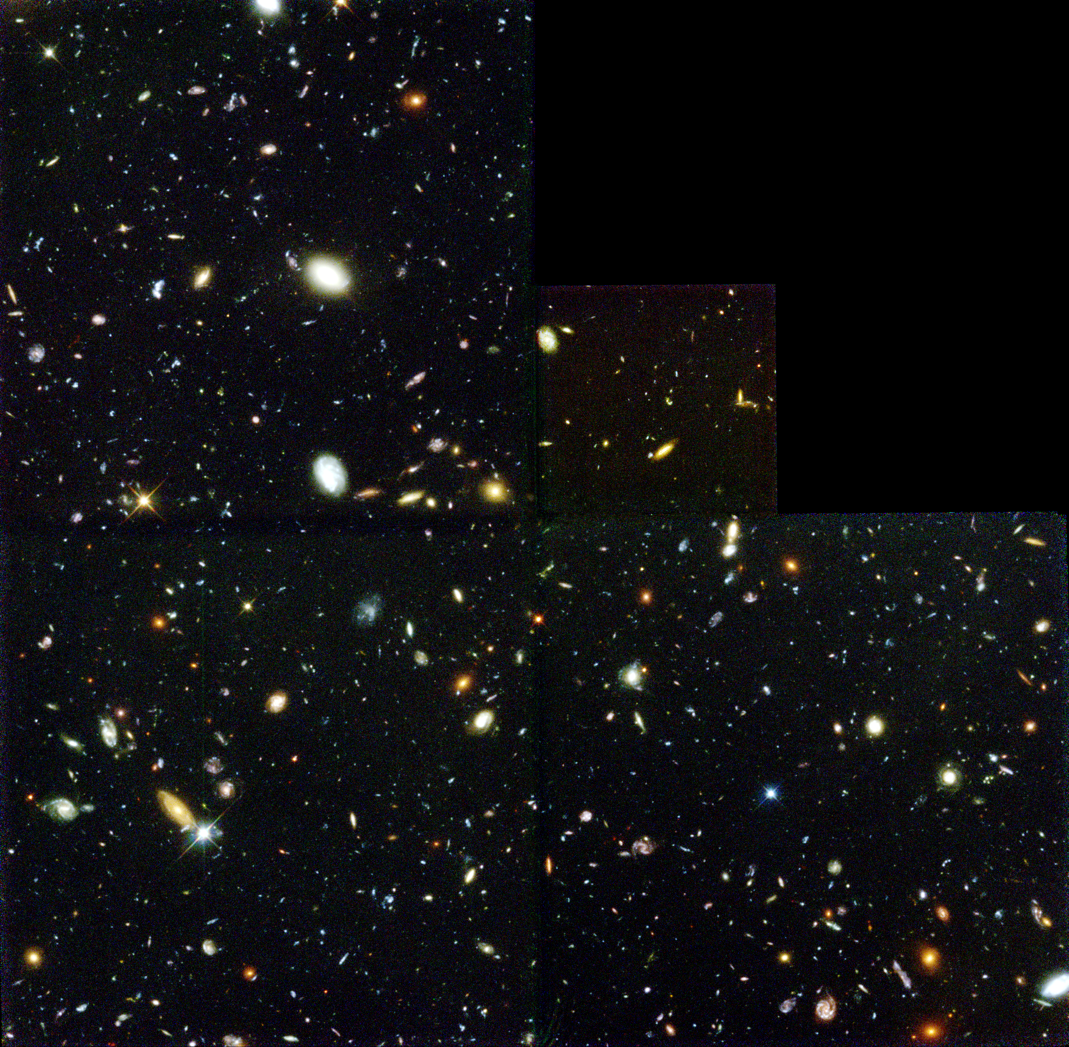
The Universe Around Us Unit 2: Cosmology (day two)

Slide 2
Hubble Deep Field (HDF; 1995)

Slide 3
Hubble Deep Field (HDF; 1995)
2.6’
2.6’

Slide 4
Hubble Deep Field (HDF; 1995)
(1/24,000,000 of the sky)
2.6’
2.6’

Slide 5
1. The Great Debate
& the distance ladder

Slide 6
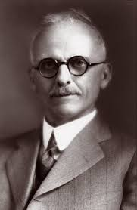
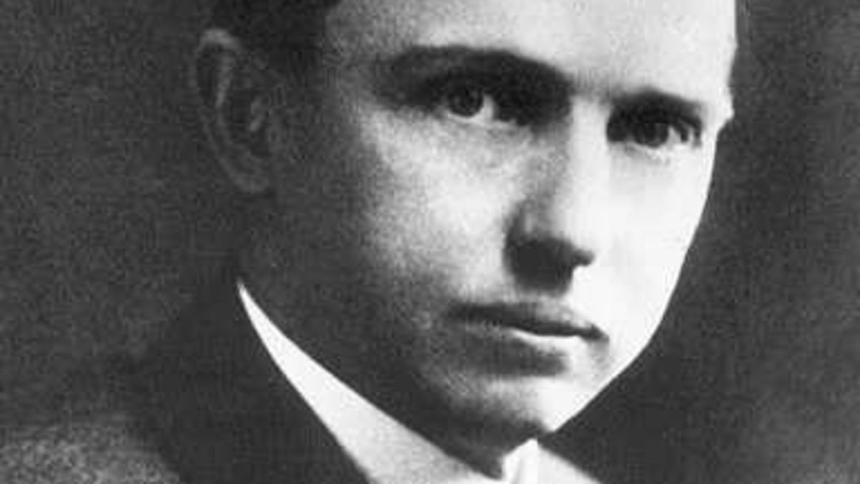
The Great Debate (1920)
(1885-1972) Harlow Shapley
(1872-1942)
Heber Curtis
V
S
“Our galaxy is the universe”
“No.”

Slide 7
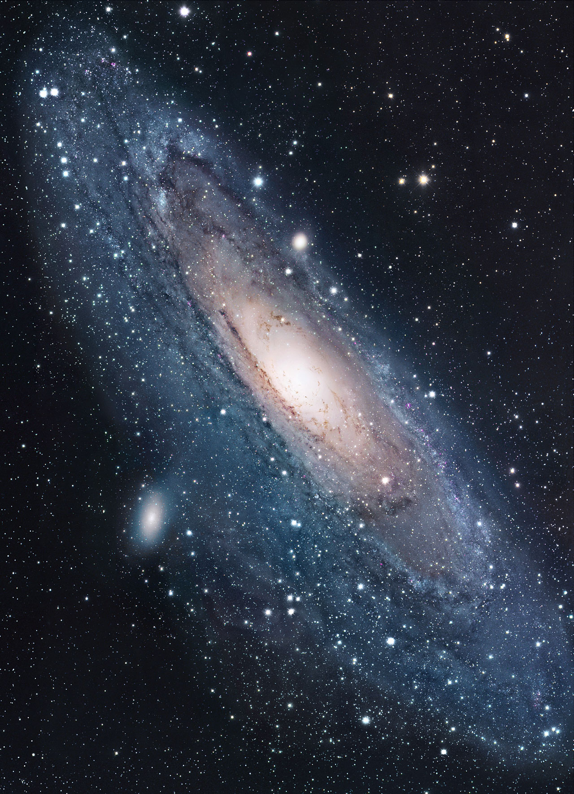
The Great Debate (1920)
(1885-1972) Harlow Shapley
(1872-1942)
Heber Curtis
V
S
“Our galaxy is the universe”
“No.”

Slide 8
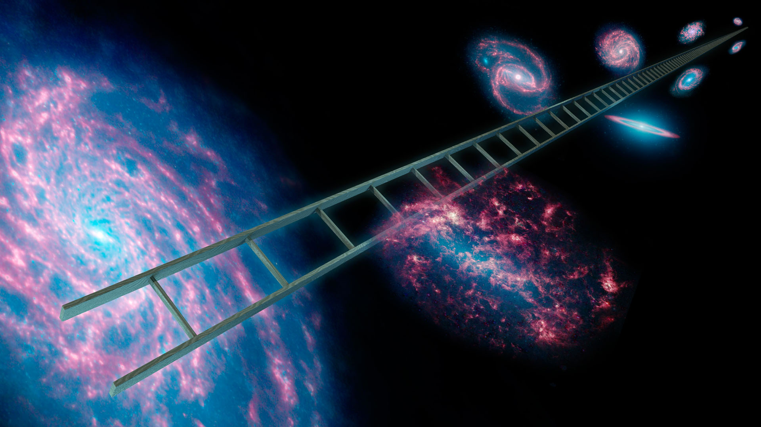
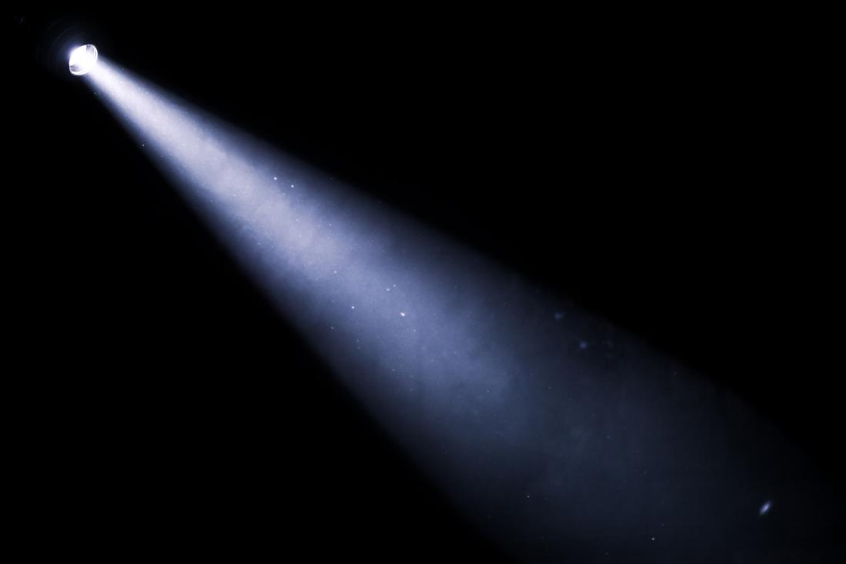
How to estimate distances?

Slide 9
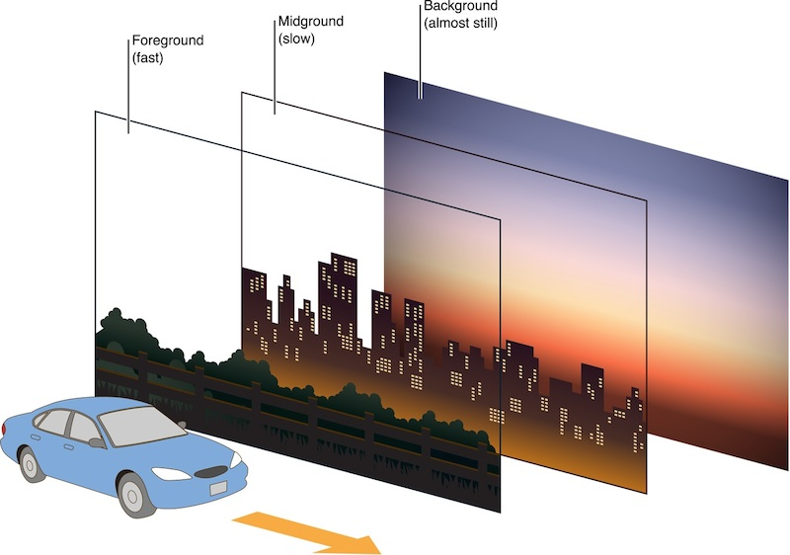
How to estimate distances?
Parallax

Slide 10
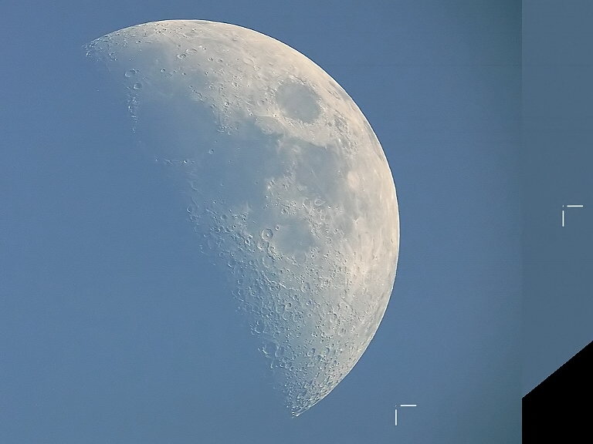
How to estimate distances?
Lunar Parallax
Images by Anthony Ayiomamitis , Athens, Greece,
Pete Lawrence, Selsey, England (May, 2007)

Slide 11
How to estimate distances?
~1000’’
Lunar Parallax
Images by Anthony Ayiomamitis , Athens, Greece,
Pete Lawrence, Selsey, England

Slide 12
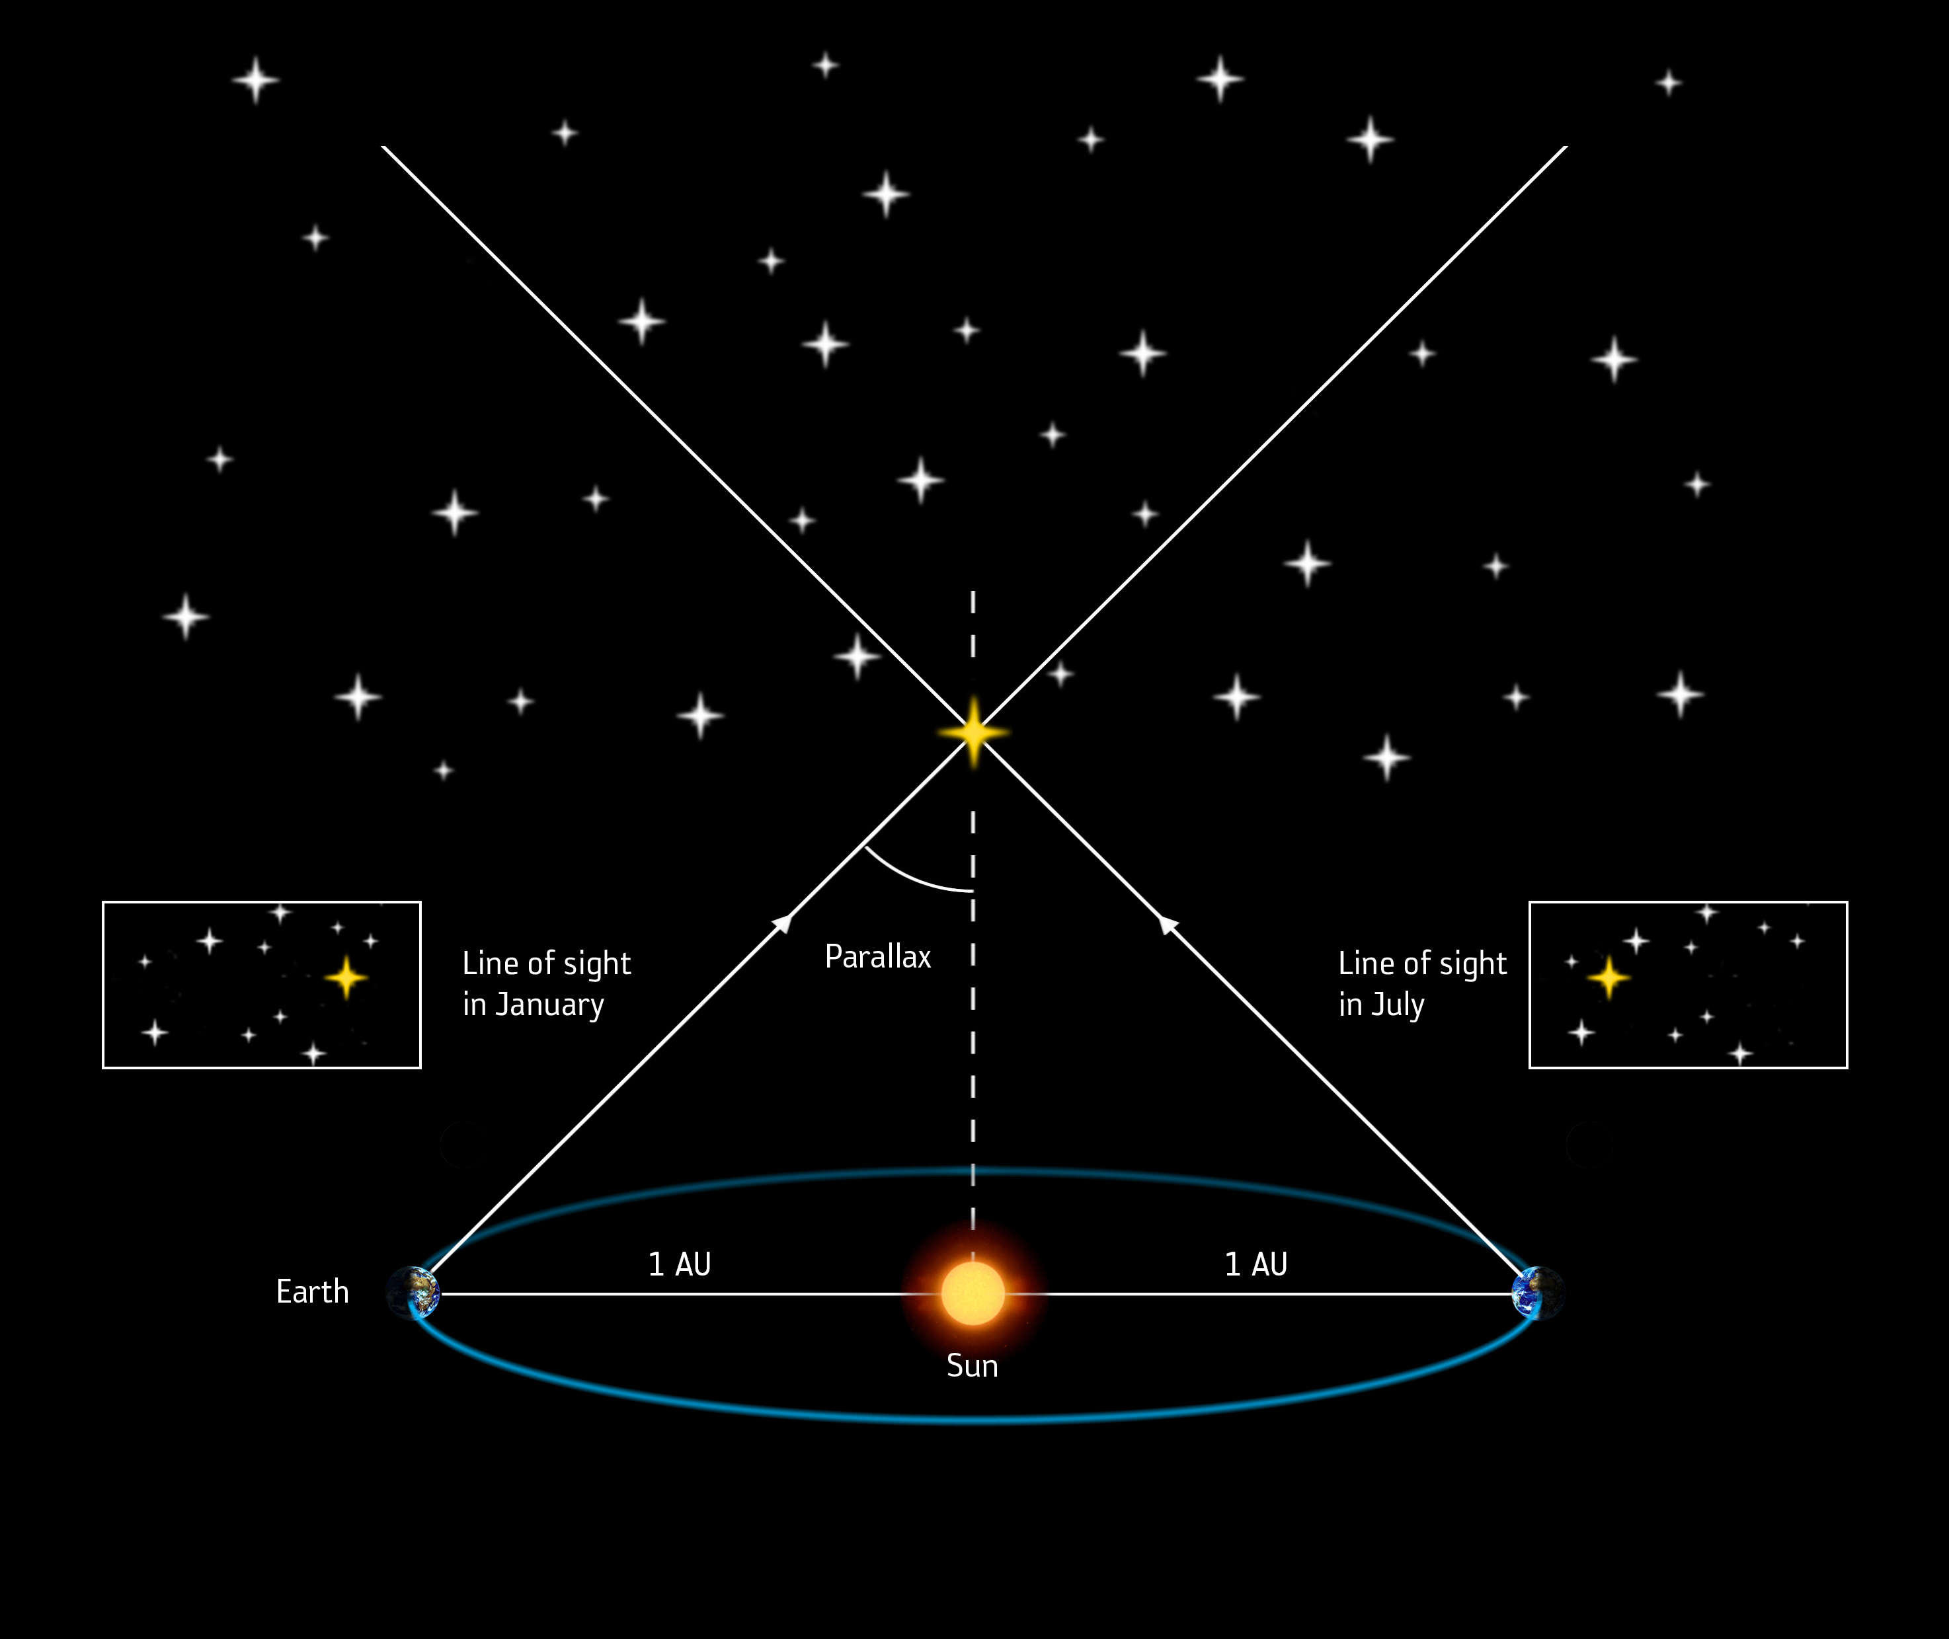
How to estimate distances?

Slide 13
How to estimate distances?
1 parsec = 3.26 ly

Slide 14
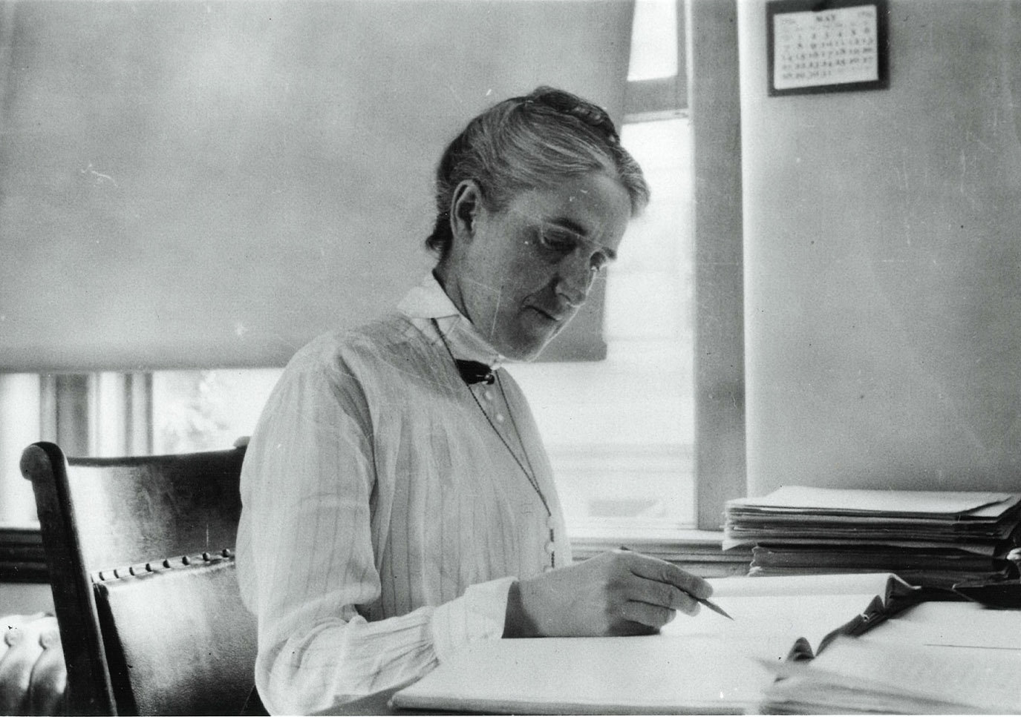
(1868-1921)
1500 1600 1700 1800 1900 2000
Copernicus
Galilei (1564-1642)
Lagrange (1736-1813)
Young
Maxwell
Noether (1882-1935)
Einstein
Brahe (1546-1601)
Kepler
Newton
Hamilton (1805-1865)
Leavitt
Planck
Henrietta Leavitt
Astronomer

Slide 15
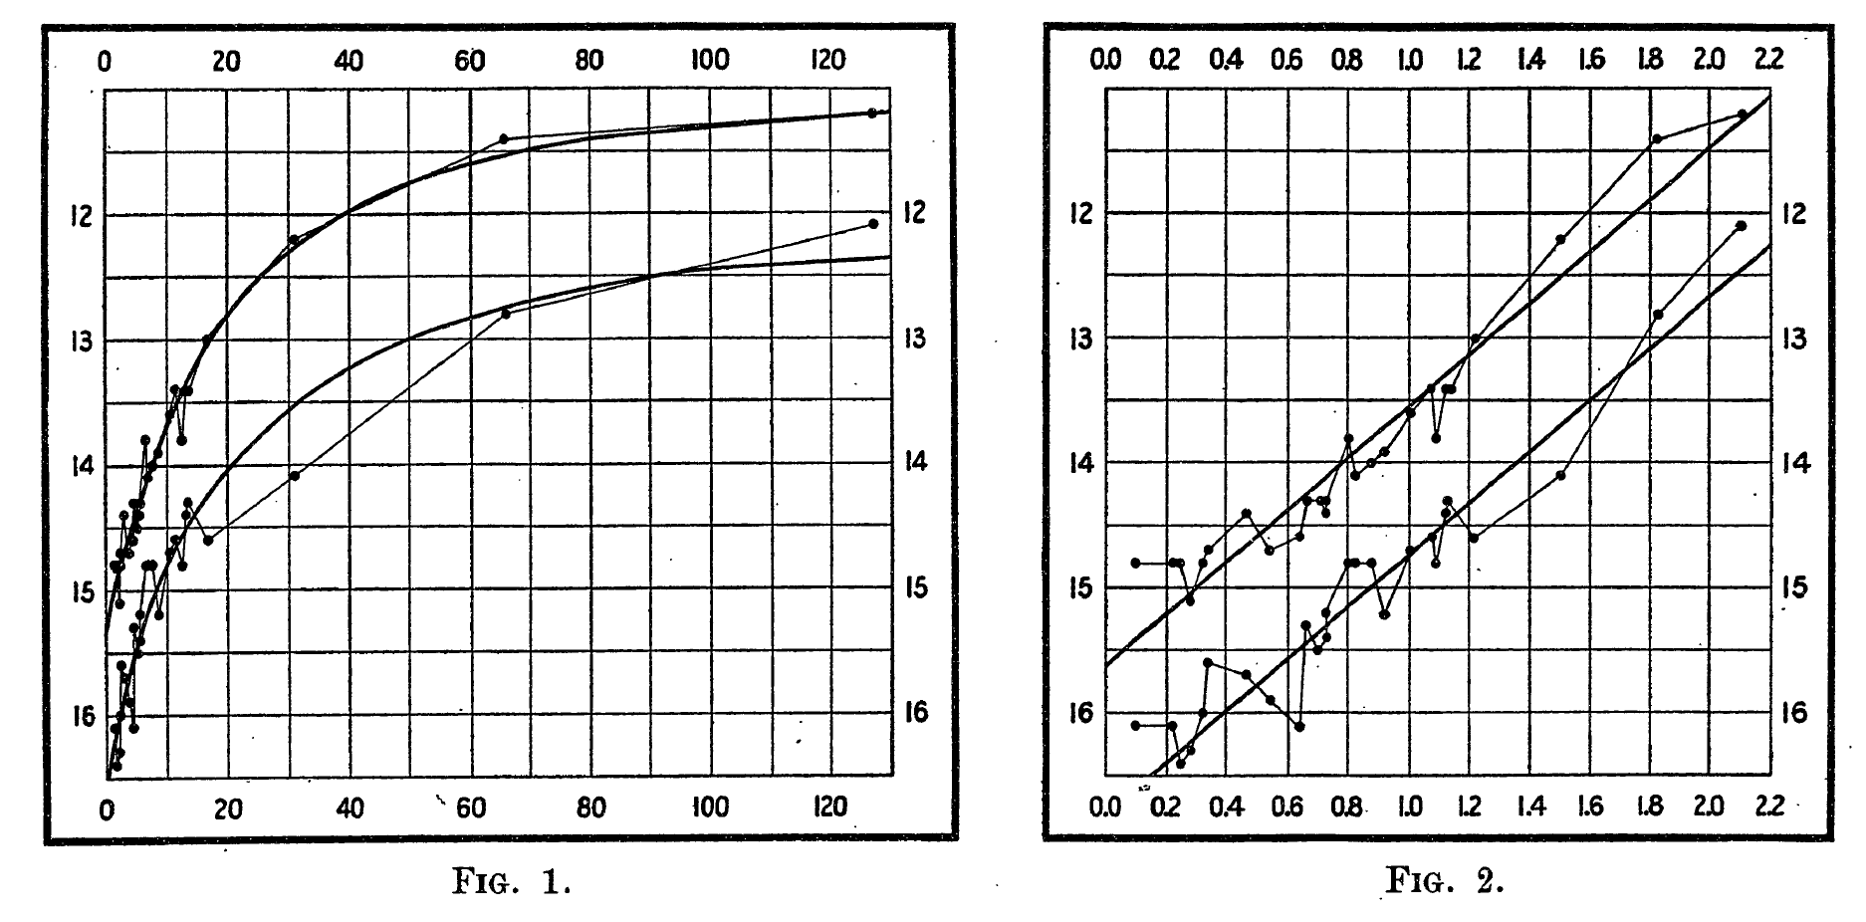
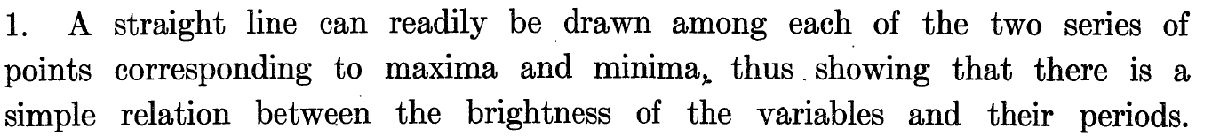
(1868-1921)
1500 1600 1700 1800 1900 2000
Copernicus
Galilei (1564-1642)
Lagrange (1736-1813)
Young
Maxwell
Noether (1882-1935)
Einstein
Brahe (1546-1601)
Kepler
Newton
Hamilton (1805-1865)
Leavitt
Planck
Leavitt & Pickering (1912)
Henrietta Leavitt
Astronomer

Slide 16
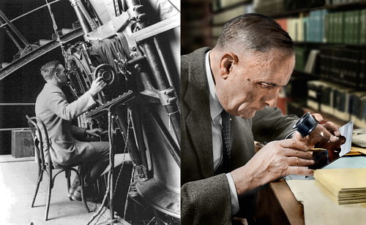
(1889-1953)
1500 1600 1700 1800 1900 2000
Copernicus
Galilei (1564-1642)
Lagrange (1736-1813)
Young
Maxwell
Noether (1882-1935)
Einstein
Brahe (1546-1601)
Kepler
Newton
Hamilton (1805-1865)
Leavitt
Planck
Hubble
Edwin Hubble
Astronomer

Slide 17
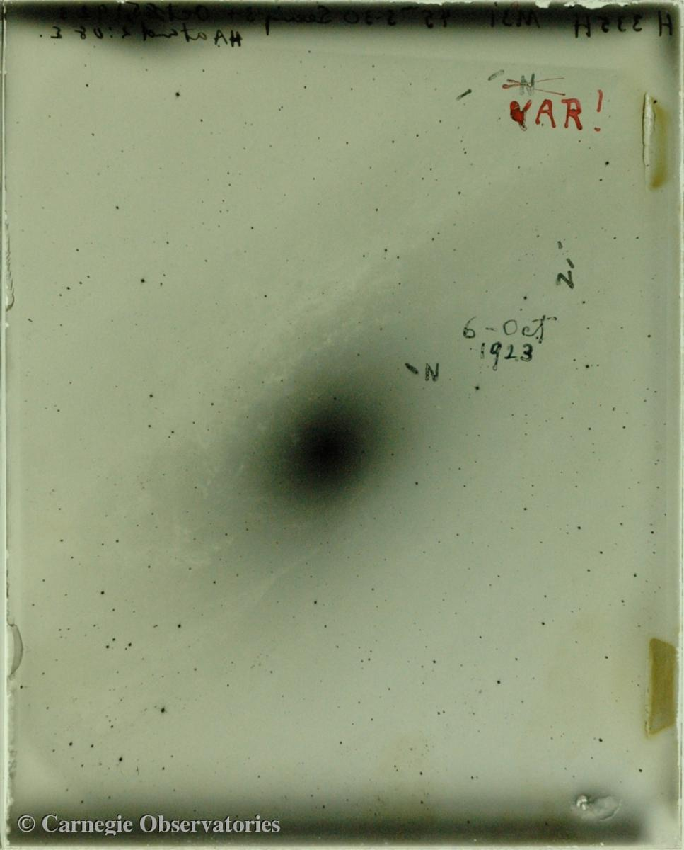
(1889-1953)
1500 1600 1700 1800 1900 2000
Copernicus
Galilei (1564-1642)
Lagrange (1736-1813)
Young
Maxwell
Noether (1882-1935)
Einstein
Brahe (1546-1601)
Kepler
Newton
Hamilton (1805-1865)
Leavitt
Planck
Hubble
Edwin Hubble
Astronomer
Hubble’s original “VAR” plate

Slide 18
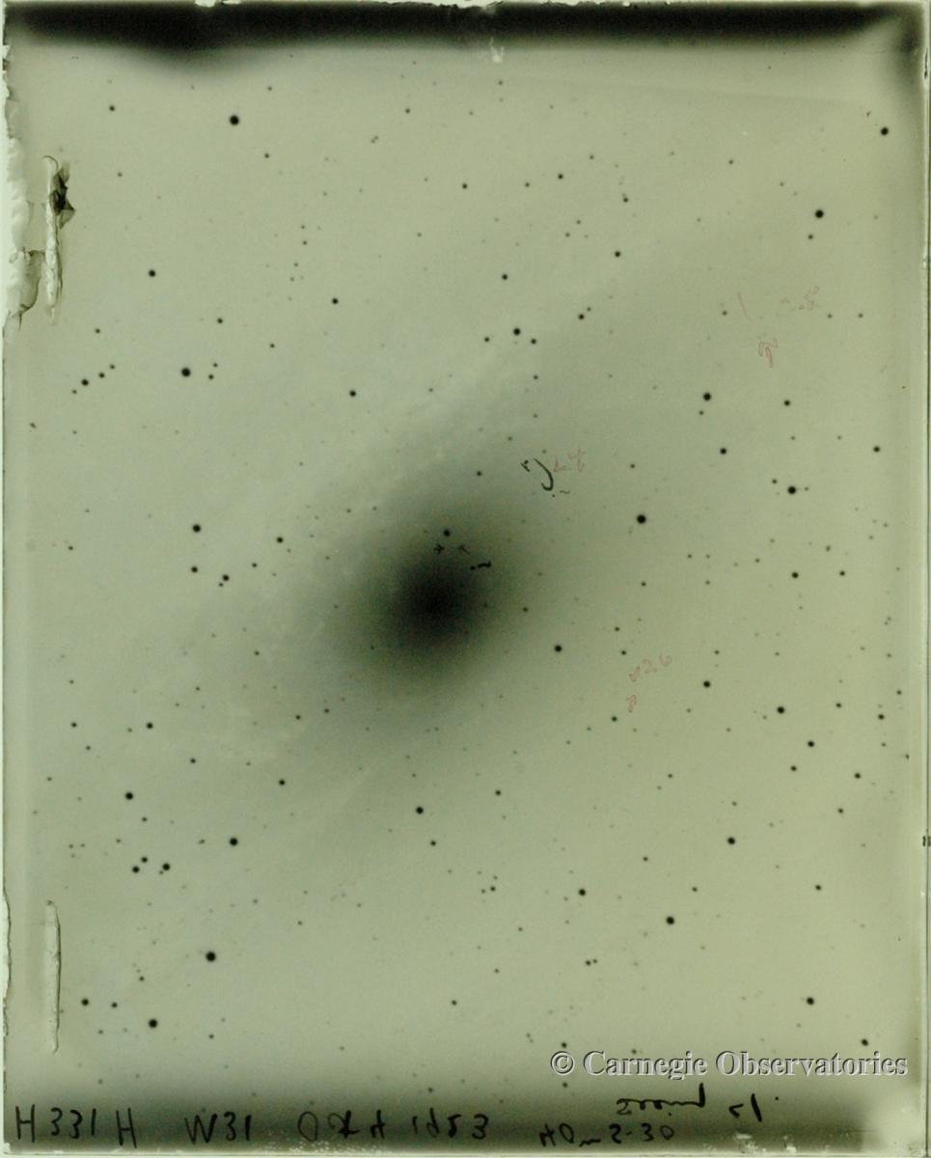
(1889-1953)
1500 1600 1700 1800 1900 2000
Copernicus
Galilei (1564-1642)
Lagrange (1736-1813)
Young
Maxwell
Noether (1882-1935)
Einstein
Brahe (1546-1601)
Kepler
Newton
Hamilton (1805-1865)
Leavitt
Planck
Hubble
Edwin Hubble
Astronomer
Hubble’s original “VAR” plate

Slide 19
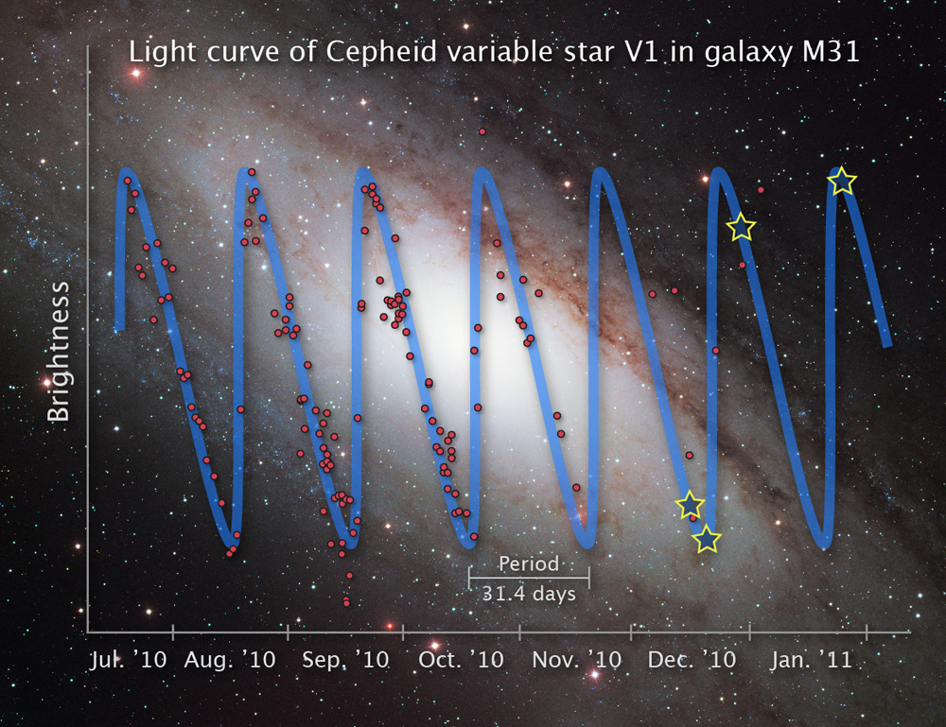
(1889-1953)
1500 1600 1700 1800 1900 2000
Copernicus
Galilei (1564-1642)
Lagrange (1736-1813)
Young
Maxwell
Noether (1882-1935)
Einstein
Brahe (1546-1601)
Kepler
Newton
Hamilton (1805-1865)
Leavitt
Planck
Hubble
Edwin Hubble
Astronomer

Slide 20
2. The expansion of the universe

Slide 21
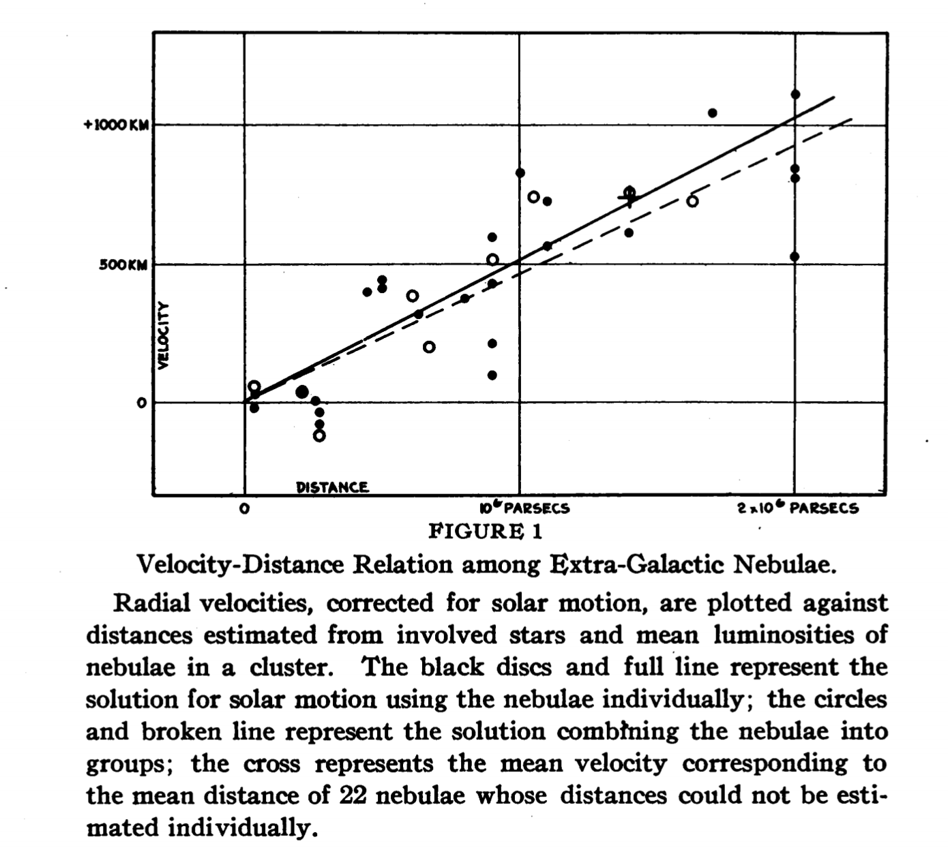
(1889-1953)
1500 1600 1700 1800 1900 2000
Copernicus
Galilei (1564-1642)
Lagrange (1736-1813)
Young
Maxwell
Noether (1882-1935)
Einstein
Brahe (1546-1601)
Kepler
Newton
Hamilton (1805-1865)
Leavitt
Planck
Hubble
Edwin Hubble
Astronomer

Slide 22
(1889-1953)
1500 1600 1700 1800 1900 2000
Copernicus
Galilei (1564-1642)
Lagrange (1736-1813)
Young
Maxwell
Noether (1882-1935)
Einstein
Brahe (1546-1601)
Kepler
Newton
Hamilton (1805-1865)
Leavitt
Planck
Hubble
Edwin Hubble
Astronomer
HOW?

Slide 23
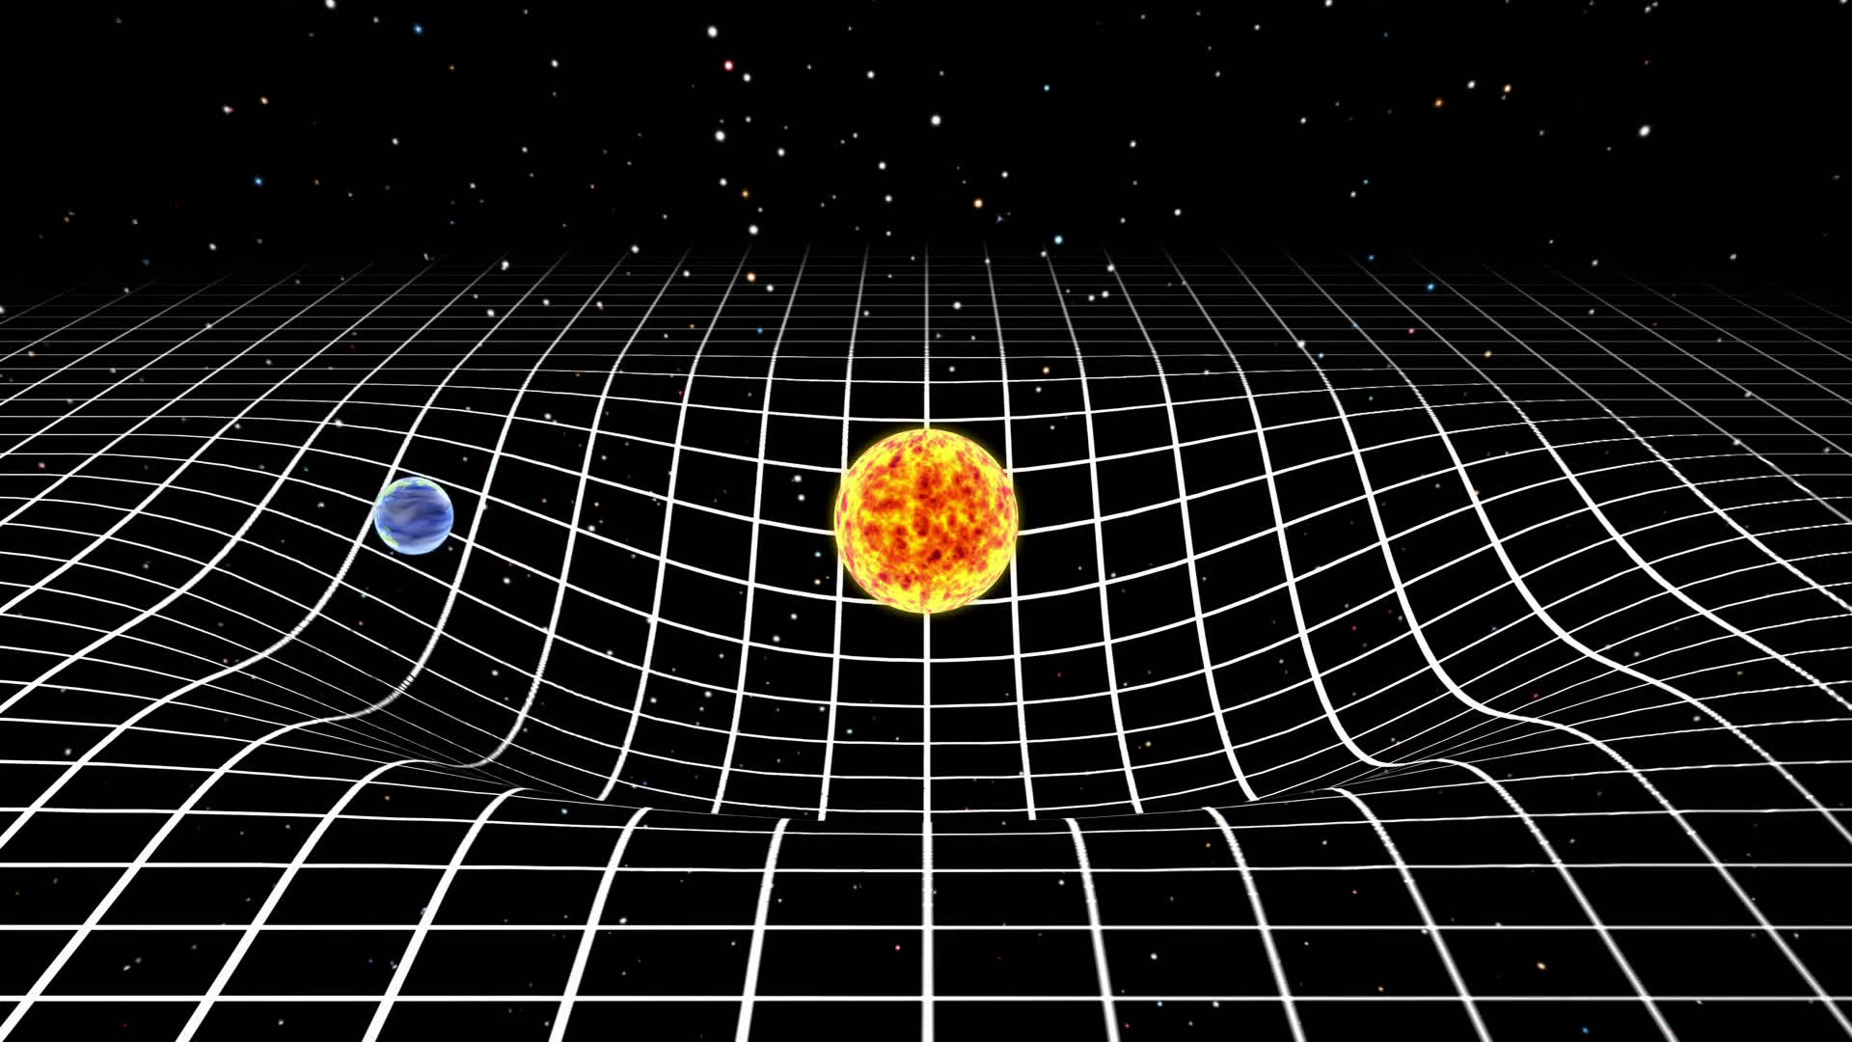
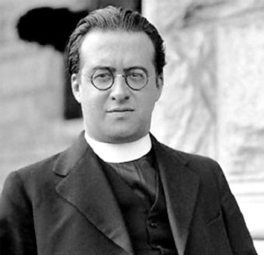
(1894-1966)
Lemaître
1500 1600 1700 1800 1900 2000
Copernicus
Galilei (1564-1642)
Lagrange (1736-1813)
Young
Maxwell
Noether (1882-1935)
Einstein
Brahe (1546-1601)
Kepler
Newton
Hamilton (1805-1865)
Leavitt
Einstein’s General Relativity (1918)
Planck
Hubble
Georges Lemaître
Astronomer

Slide 24
(1894-1966)
Lemaître
1500 1600 1700 1800 1900 2000
Copernicus
Galilei (1564-1642)
Lagrange (1736-1813)
Young
Maxwell
Noether (1882-1935)
Einstein
Brahe (1546-1601)
Kepler
Newton
Hamilton (1805-1865)
Leavitt
Planck
Hubble
Georges Lemaître
Astronomer

Slide 25
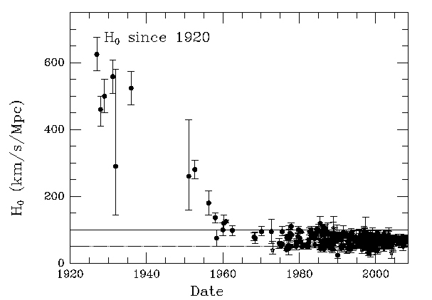
Lemaître
1500 1600 1700 1800 1900 2000
Copernicus
Galilei (1564-1642)
Lagrange (1736-1813)
Young
Maxwell
Noether (1882-1935)
Einstein
Brahe (1546-1601)
Kepler
Newton
Hamilton (1805-1865)
Leavitt
Planck
Hubble
Hubble-Lemaître Constant

Slide 26
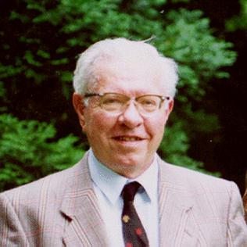
(1915-2001)
Lemaître
1500 1600 1700 1800 1900 2000
Copernicus
Galilei (1564-1642)
Lagrange (1736-1813)
Young
Maxwell
Noether (1882-1935)
Einstein
Brahe (1546-1601)
Kepler
Newton
Hamilton (1805-1865)
Leavitt
Planck
Hubble
Fred Hoyle
Astronomer
“The reason why scientists like the "big bang" is because they are overshadowed by the Book of Genesis. It is deep within the psyche of most scientists to believe in the first page of Genesis”
- Hoyle (BBC, 1948)

Slide 27
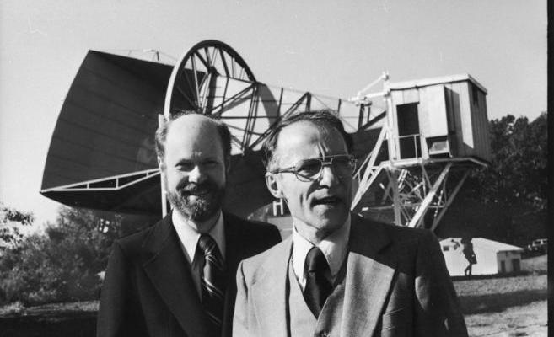
Lemaître
1500 1600 1700 1800 1900 2000
Copernicus
Galilei (1564-1642)
Lagrange (1736-1813)
Young
Maxwell
Noether (1882-1935)
Einstein
Brahe (1546-1601)
Kepler
Newton
Hamilton (1805-1865)
Leavitt
Planck
Hubble
(1933-)
(1936-)
Robert Wilson
Arno Penzias
Cosmic Microwave Background discovery: 1965

Slide 28
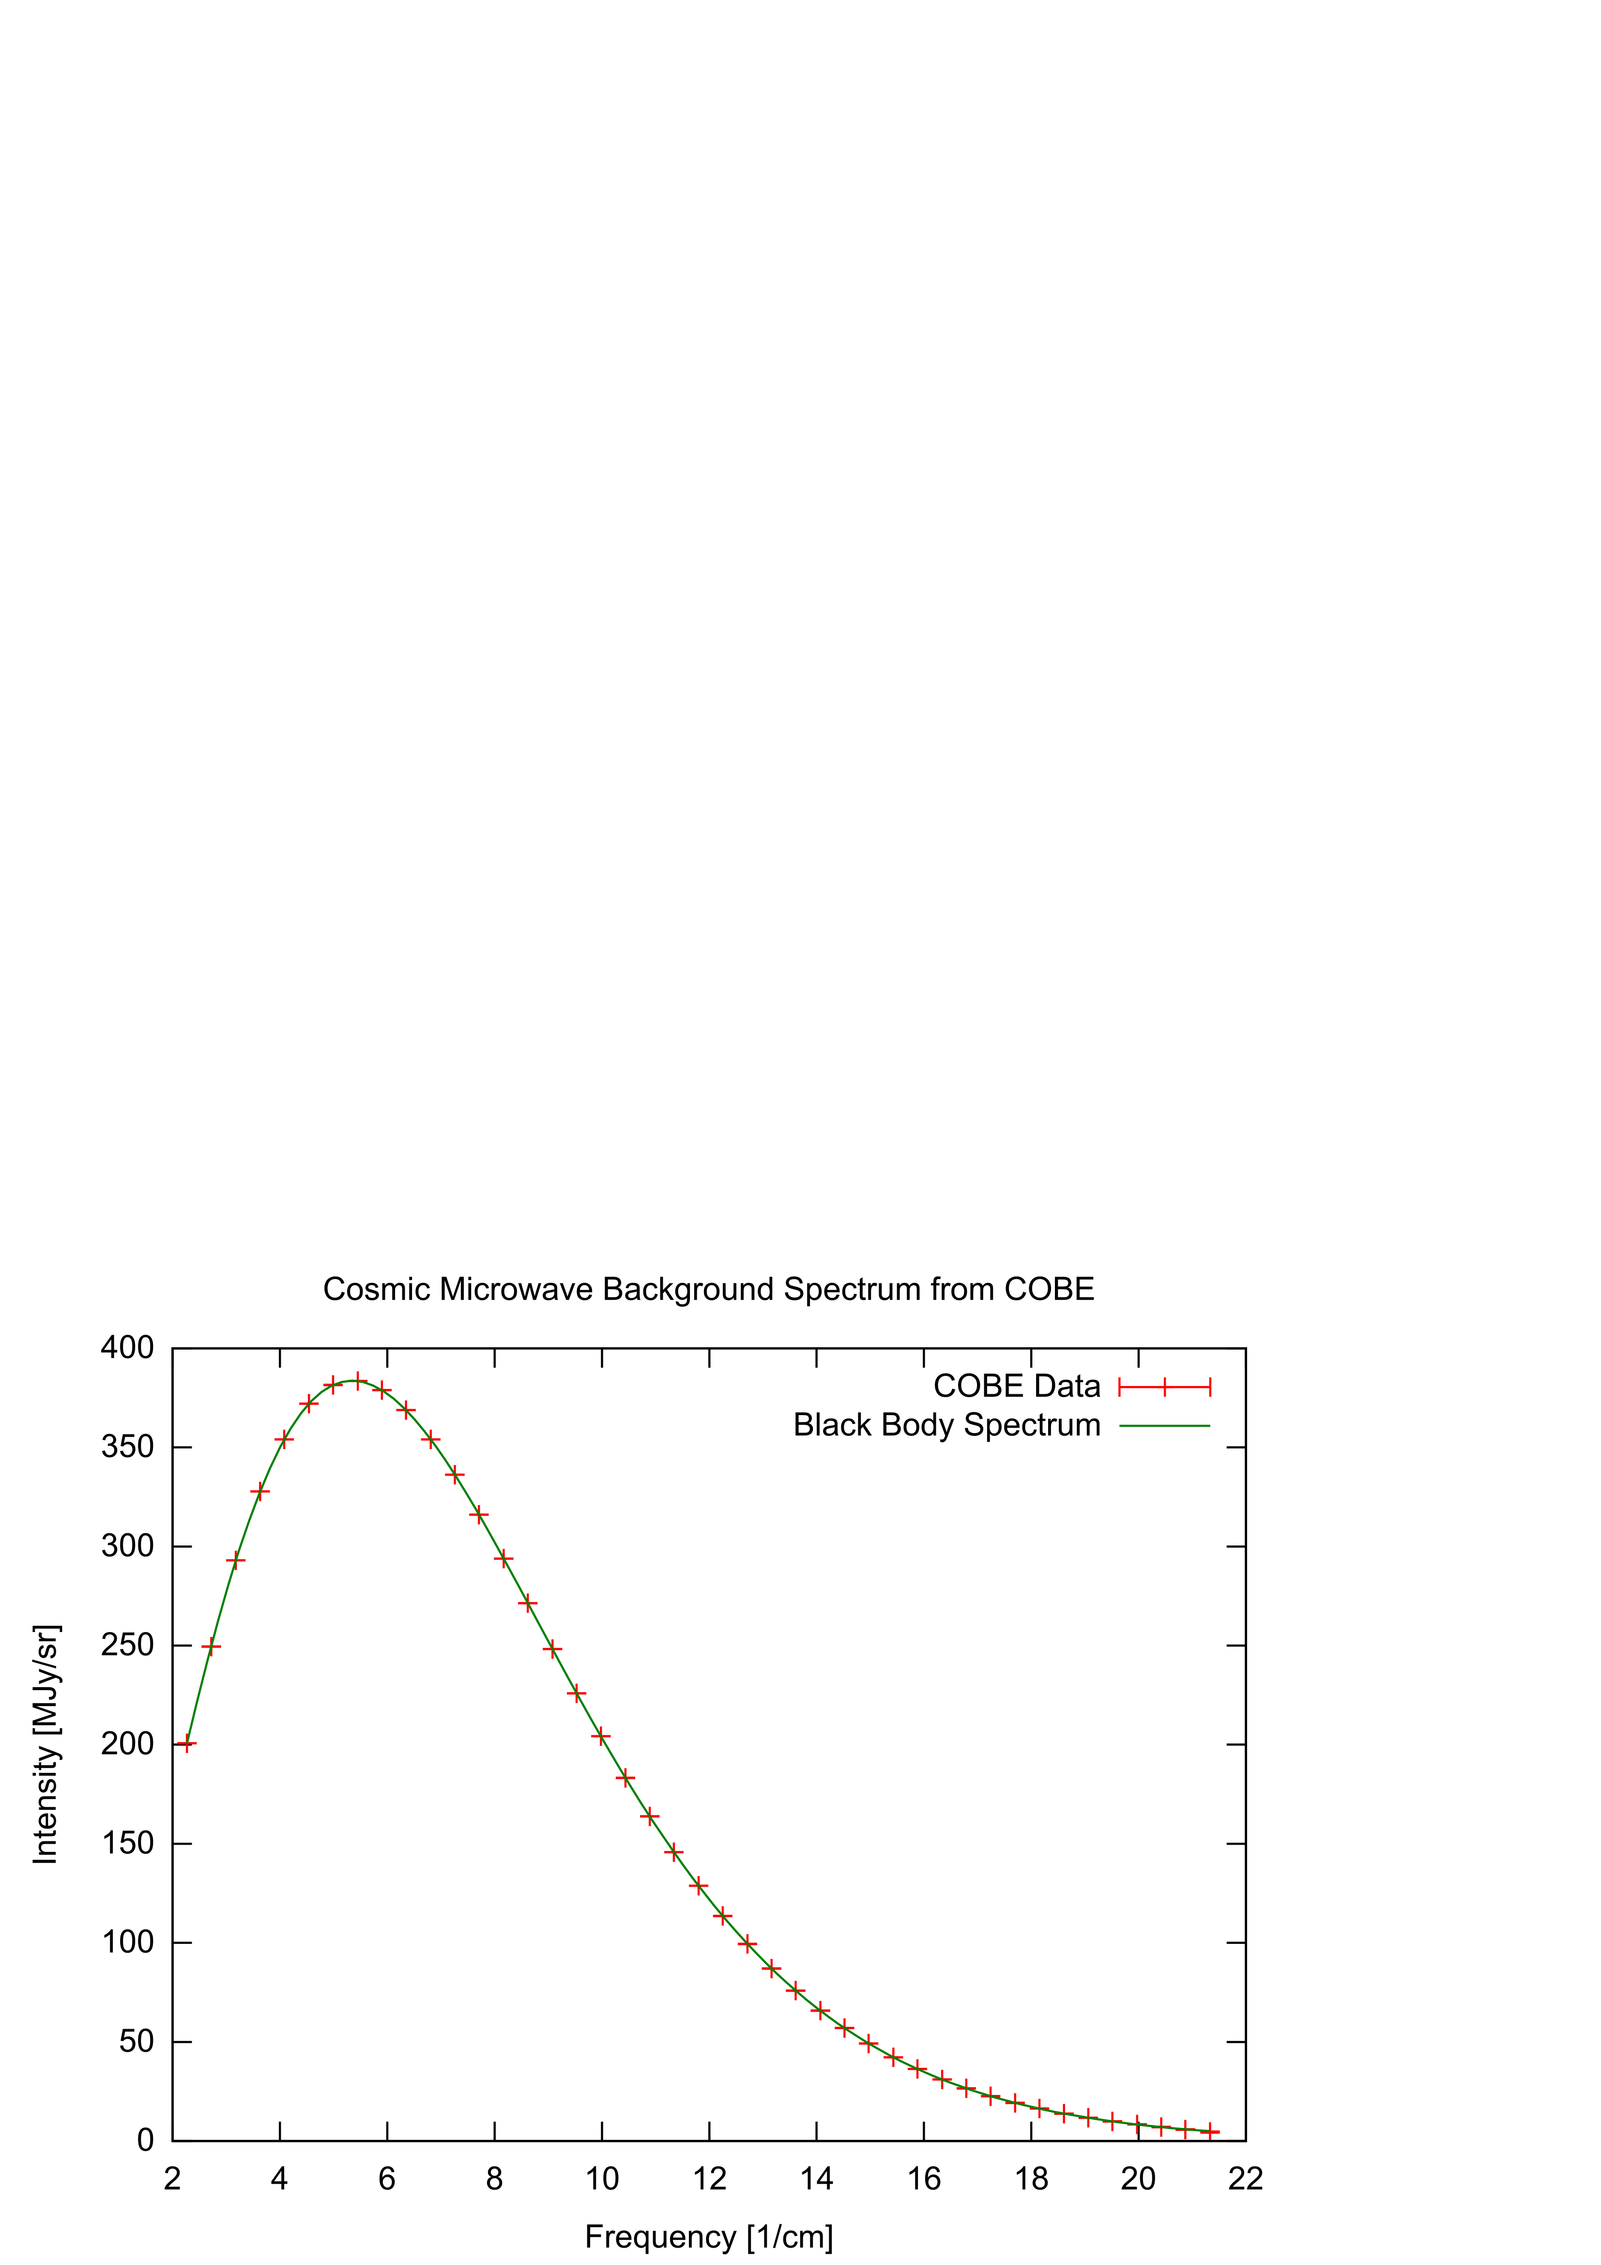
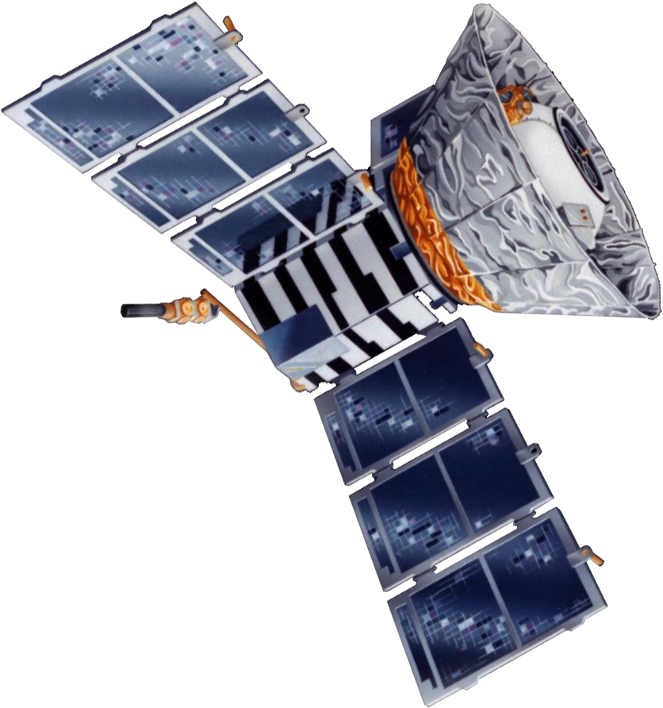
Lemaître
1500 1600 1700 1800 1900 2000
Copernicus
Galilei (1564-1642)
Lagrange (1736-1813)
Young
Maxwell
Noether (1882-1935)
Einstein
Brahe (1546-1601)
Kepler
Newton
Hamilton (1805-1865)
Leavitt
Planck
Hubble
(1989-1993)
COBE

Slide 29
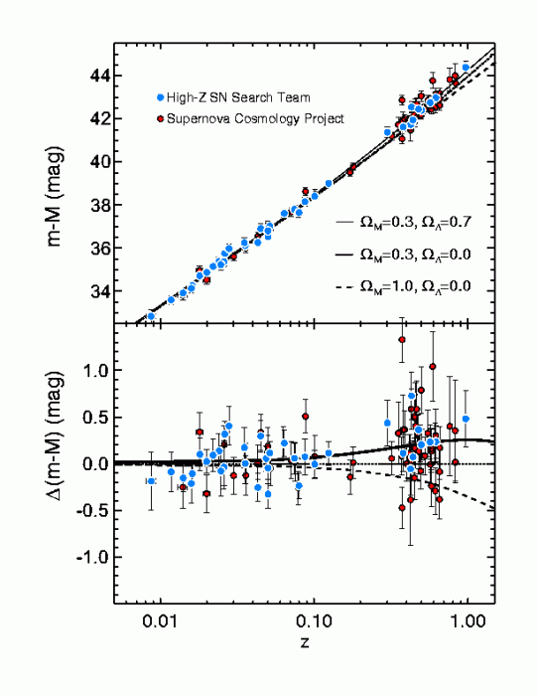
Lemaître
1500 1600 1700 1800 1900 2000
Copernicus
Galilei (1564-1642)
Lagrange (1736-1813)
Young
Maxwell
Noether (1882-1935)
Einstein
Brahe (1546-1601)
Kepler
Newton
Hamilton (1805-1865)
Leavitt
Planck
Hubble

Slide 30
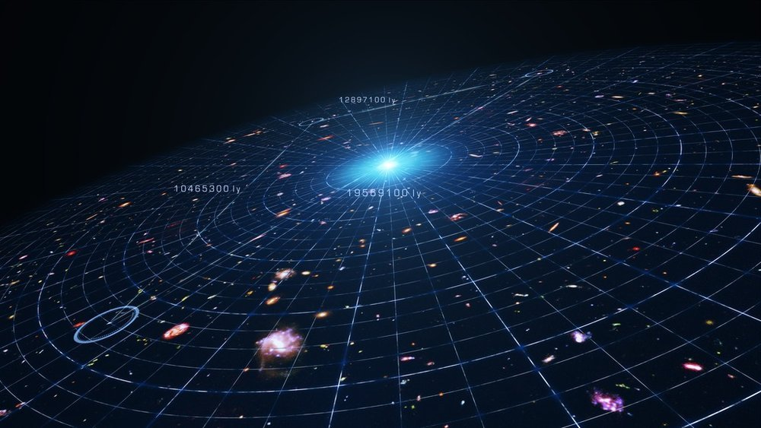
Lemaître
1500 1600 1700 1800 1900 2000
Copernicus
Galilei (1564-1642)
Lagrange (1736-1813)
Young
Maxwell
Noether (1882-1935)
Einstein
Brahe (1546-1601)
Kepler
Newton
Hamilton (1805-1865)
Leavitt
Planck
Hubble

